Slide 1
Home Equity Loan Default Prediction:
A Machine Learning Approach
By:
Jacob Stys

Slide 2

Summary and Research Question
Rise in mortgage rates.
Difficulty for cash-out refinance
Having the ability to have a home equity line of credit gives people the ability to pull equity out of their home and consolidate credit cards, pay for home improvement, investments, and medical bills etc.
The research in question is can we predict the result of loans being paid off or defaulting given the selected variables and can we identify variables that have high prediction power in the dataset.

Slide 3
Dataset Importance and Uses
Who is this dataset important to.
Deciding whether to approve a home equity loan application or deny it is crucial because it could lead to foreclosure, which in turn leads to the bank losing money.
Getting an idea of each features importance to the model will be important for underwriters to assess loan applications effectively and correctly.

Slide 4

Goal and Metrics
Goal of this project
Using accuracy and recall will give an idea how well the model is performing.
The higher the accuracy the more correctly predicted loan classification.
The higher the recall the more correctly predicted True positive loans.

Slide 5
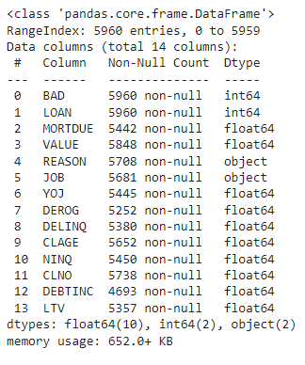
Dataset Details
Contains 5,960 Rows with 13 independent variables.
The dependent variable ‘BAD’ is if the loan defaulted (1) or was paid off (0).
Data was obtained from Kaggle-https://www.kaggle.com/datasets/ajay1735/hmeq-data
About 20% of the data were defaulted loans and 80% were paid off loans.
Description of independent variables can be found on the Kaggle site.

Slide 6
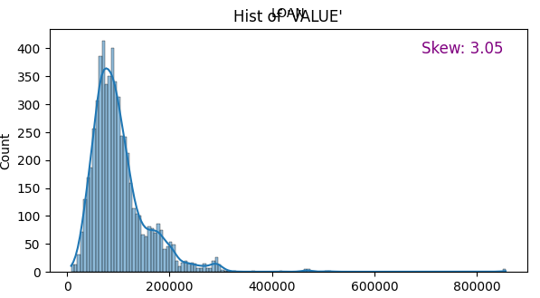
Data Cleansing and Exploration
Decided to drop 50 rows where a lot of variables were missing and used data imputer to replace continuous missing values with the mean totaling to over 2000 rows being replaced.
Made Derogatory Reports and Delinquents a binary variable to 0 and 1.
1 being that they have a least 1 derogatory report or 1 delinquent report and 0 if they did not.
Created a loan to value ratio variable as it is used in approving loans.
Check for skewness in independent variables which is needed to satisfy the normality assumption when creating a model.
The variable value is skewed and I addressed it by performing a winsorization on it, which makes extreme values less extreme.
I applied the winsorization on value, clage, debt to income, and mortgage due as they were skewed.

Slide 7
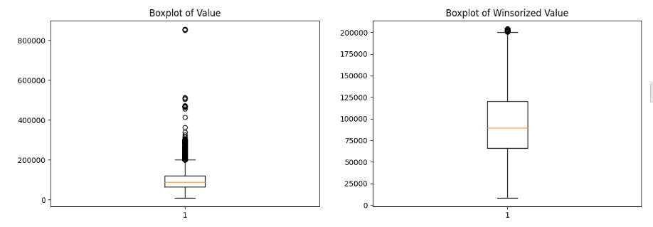
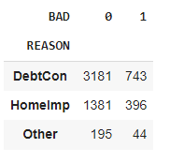
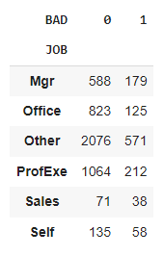
Data Cleansing and Exploration cont.
Replaced categorical missing values with the ‘Other’ as its own type.
Totaled number of rows with imputed data and categorical replaced was 5940.
EX. Winsorized value compared to normal value.
EX. Job and Reason Crosstabs.

Slide 8
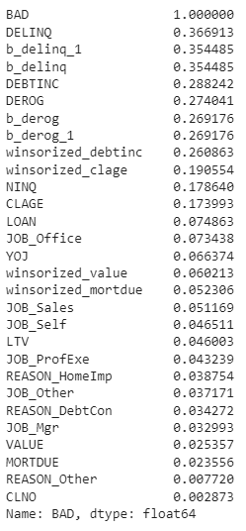
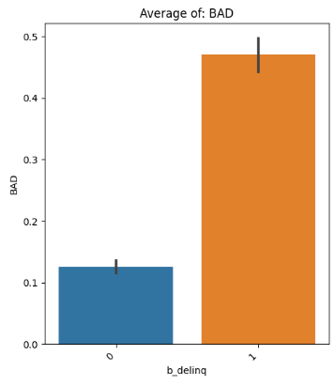
Data Cleansing and Exploration final.
Encoded categorical variables to dummy columns for easier model evaluation.
Reason, Job, and derogatory reports, and delinquencies encoded with prefix and name of value.
Check final correlation to check which values will most likely be able to predict the independent variable BAD.

Slide 9
Significant Variables
In the Model
Significant encoded categorical variables using dummy variables which include: Job type, Reason, derogatory reports, and delinquent credit cards.
Significant continuous variables include: Debt to Income, clage, loan, Years of job, value, NINQ, and mortgage due.

Slide 10
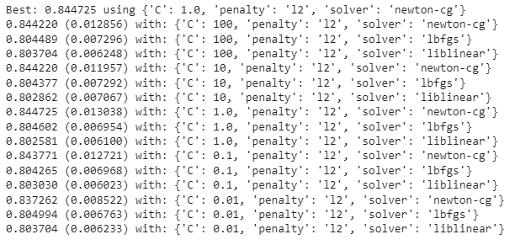
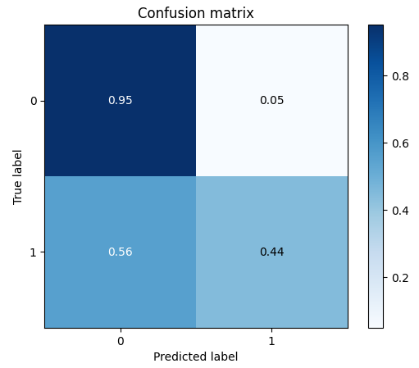
Logistic Regression
First model is Logistic Regression since this is a classification problem.
Used libraries from sklearn include: RepeatedStratifiedKFold, GridSearchCv, and Logistic Regression
Used 10 kFoldCrossValidation to overcome any overfitting of the data with 3 repeats.
Best model hyperparameters include a C value of 1.0, L2 penalty, and newton-cg solver.
Obtained an Accuracy of .845 and a recall of .44.
Overall our model had a strong accuracy but a low recall so this model is not significant enough to be used.

Slide 11

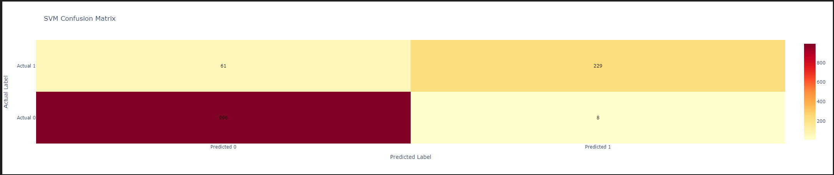
SVM
Accuracy
Highest Recall
Tuned Hyper Parameters
Best Model

Slide 12
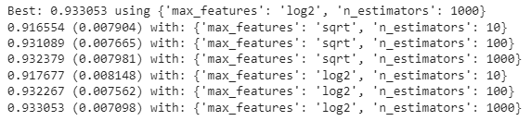
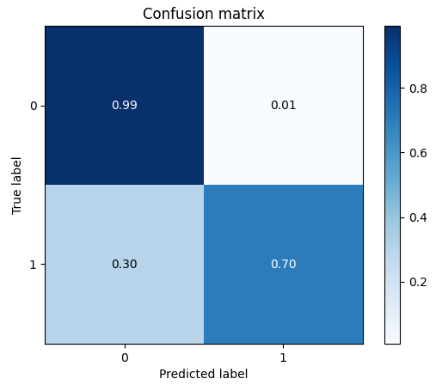
Random Forest Classifier
Repeated steps from the Logistic Regression but used different hyperparameters.
Tested for n_estimators in the model (10, 100, 1000) as well as max_features in the model (square root or log).
Best accuracy of .933 with max_features as log2 and n_estimators as 1000.
Best recall record was .701 with max_features as log2 and n_estimators as 1000.
Model made some improvements to the data but there is more room for improvement when it comes to the recall value.

Slide 13
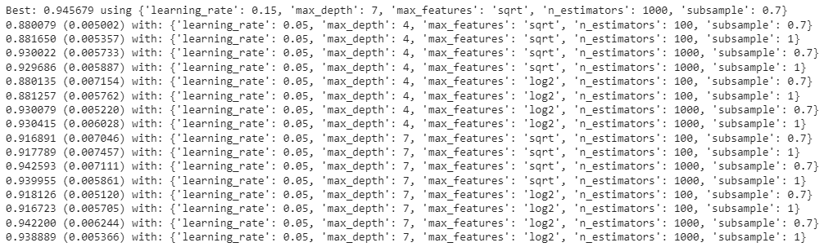
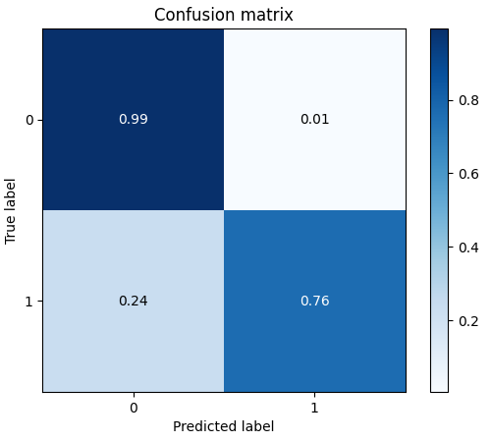
Gradient Boosting Classifier
Repeated step from previous models but doing 5 cross validations and 3 repeats.
Hyper parameters to test include subsample .7 or 1, n_estimators 100 or 1000, learning_rate of 0.05, 0.1, 0.15, and max depth of 4, 7, 9.
Results showed an Accuracy of 0.946 and a recall of 0.76.
The hyperparameters used for accuracy include max_depth of 7, max_features of square root, n_estimators of 1000, learning rate of 0.15, and subsample of 0.7.
This being the highest accuracy and recall scores using this model would be ideal.

Slide 14
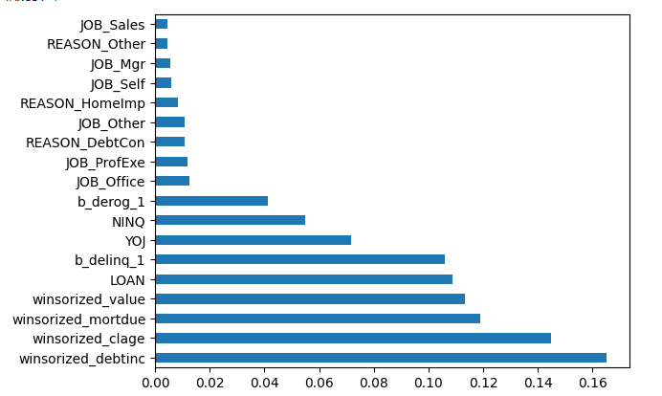
Key Takeaways
After assessing the dataset we can conclude the following:
The more complex the model becomes the stronger the accuracy and recall was returned
More data and less missing data could help improve the model.
Predictability and accuracy was great and recall score of 0.76 is pretty good.
Variables like number of assets or additional properties could play a factor in predicting a loan would default or not.
Overall having an Accuracy of 0.946 and a recall of 0.76 from the Gradient Boosting Classifier is good but would prefer a stronger recall.
List of Feature importance of the gradient boosting classifier.
With this model, we identified significant variables in predicting home equity loan outcomes which can assist underwriters and banking institutions when approving loan applications.
For model deployment, plugging in the specified variables for a specific loan will result in a 95.55% accuracy of predicting the outcome of the loan, which an underwriter can use to make a decision.

Slide 15
Limitations
Some limitations to this model include:
Geographical Location/ Housing Markets
Missing Data
Limited Amount of Data
Specified data on geographical location and housing markets which would lead to model reusability in local markets.
More data in general could lead to a better model fit which would strengthen results.
Having fewer missing data could lead to more accurate results and predictability.
This data applies only to home equity loans and not to residential mortgages.

Slide 16
Links
Data-https://www.kaggle.com/datasets/ajay1735/hmeq-data/code
Github-https://github.com/jake052799/ThinkfulProjectsAssessmentsandData/tree/main/Capstone%20Folder/HMEQCapstone2
CodeEX-https://machinelearningmastery.com/hyperparameters-for-classification-machine-learning-algorithms/
Google Doc-https://colab.research.google.com/drive/1YX1QldcjEngQhNRlBUz9WCapMzi-HDsr?usp=sharing

Slide 17
Questions

